Slide 1
CS 4530: Fundamentals of Software Engineering Module 10.4: Case Studies
Adeel Bhutta, Joydeep Mitra, Mitch Wand
Khoury College of Computer Sciences
© 2025 Released under the CC BY-SA license

Slide 2
Learning Goals for this Lesson
By the end of this lesson you should be able to:
Briefly describe several typical examples of distributed systems
Briefly describe how each of them deals with scalability, fault tolerance, etc.

Slide 3
Case Study 1: the Network File System NFS
NFS is a distributed file system: multiple clients can read/write the same files
Created in 1984, still widely used
In a UNIX (POSIX-compliant) operating system, files are stored in a tree from “/”
Access a remote file by name like /username@remotehost/path/to/remote/file
Or you could “mount” a remote filesystem to access it as if it were local.
Notes:
<Read slide>

Slide 4
NFS is a Monolithic Shared Filesystem
All files are stored on a single server
To list files in a directory, clients make request to server
To read or write files, clients make request to server
Clients might “lock” files to prevent concurrent updates
Assuming that scale, throughput, fault tolerance requirements are relatively low, this is an acceptable architecture
This architecture is the easiest to build fast and correctly
Notes:
<Read slide>

Slide 5
Case Study 2: GFS (Google File System, ~2010)
Stated requirements:
“High sustained bandwidth is more important than low latency. Most of our target applications place a premium on processing data in bulk at a high rate, while few have stringent response time requirements for an individual read or write.”
Notes:
How might we consider applying this idea of partitioning to a network filesystem, like our NFS monolith?
A classic example of tiering distributed filesystems is GFS, the Google File System.
(Read stated requirements in slide)
The key problem is that the throughput of a single server is limited, so we need some way to have multiple servers, so that clients can read/write files on those different servers, allowing for scaling. But how do we coordinate multiple servers?

Slide 6
GFS is a tiered filesystem with two tiers: Metadata and File Chunks
Example: GFS (Google File System, c 2010)
Where is file /foo/bar?
GFS Metadata
Metadata tier stores where files are stored, in 128MB chunks
GFS Client
List of chunks and their locations
GFS Client
GFS Client
GFS Client
Reads chunks from the specific Chunk Servers known to have them
GFS Client
GFS Client
GFS Client
ChunkServer
ChunkServer
ChunkServer
ChunkServer
ChunkServer
ChunkServer
ChunkServer
ChunkServer
ChunkServer
ChunkServer
Chunk tier stores each 128MB chunk, no need for coordination between ChunkServers not storing same chunk
ChunkServer
ChunkServer
ChunkServer
ChunkServer
ChunkServer
ChunkServer
ChunkServer
ChunkServer
ChunkServer
ChunkServer
ChunkServer
ChunkServer
ChunkServer
ChunkServer
Notes:
To achieve these stated requirements, GFS’ architecture is split into two tiers.
Each file is split into multiple “chunks” of 128MB.
One of the tiers is a Metadata tier, which knows the names of each of the files, and for each file, knows where the “chunks” are.
The Chunk tier stores each of the 128MB chunks.
For a client to read a file, like “/foo/bar”, it first asks the metadata tier for the list of chunks and the chunk servers that have it. Then, it can directly connect to the relevant chunk servers in the chunk tier and read the file.
The chunk tier can scale extremely efficiently, because supporting more (and bigger) concurrent reads/writes just means that we add more chunk servers. This tiering can be further expanded so that chunks are replicated between multiple chunk servers, creating yet another tier, but getting into the details of GFS further is really the topic of a distributed systems class.
Of course: there might be a bottleneck on the metadata tier: every single request will pass through it (to find which chunk server to talk to). But: the requirements stated that it was OK for there to be a latency to start a large read or write - so this is an adequate design for the requirements. Within Google, GFS has since been replaced by a much more complex system that alleviates this bottleneck, but this design is widely deployed today - the very popular “Hadoop” map/reduce library implements a distributed filesystem “HDFS” which is exactly this one!
Our important takeaway for GFS is that it allows for high-throughput reads and writes by allowing this “chunk” tier to scale with little limitation.

Slide 7
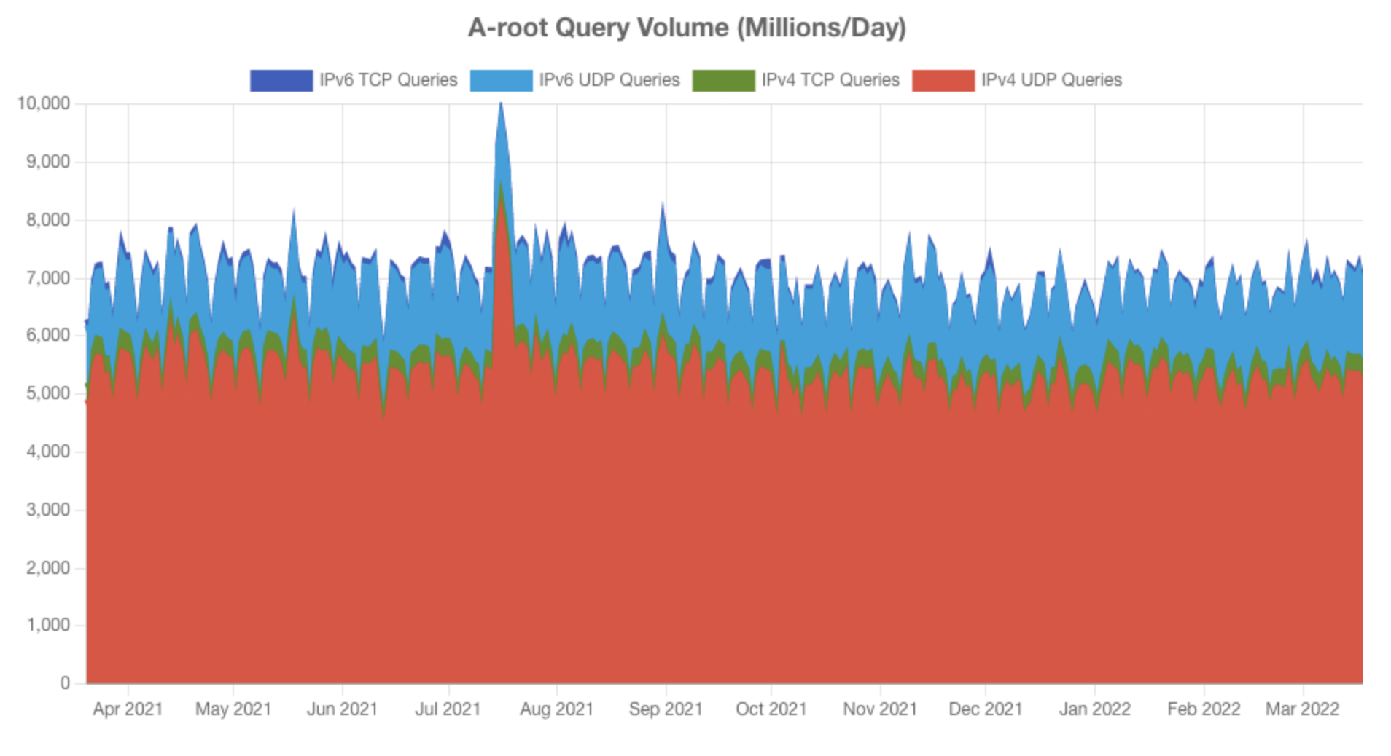
Case Study 3: Domain Name System (DNS)
Nodes (hosts) on a network are identified by IP addresses
E.g.: 142.251.41.4
We humans prefer something easier to remember: calendar.google.com, facebook.com, www.khoury.northeastern.edu
We need to keep a directory of domain names and their addresses
We also need to make sure everybody gets directed to the correct host
https://a.root-servers.org/metrics
Notes:
The Domain Name System is a classic example of a distributed system. DNS is a fundamental service on the internet, which maps human-readable names like facebook.com to numerical IP addresses.
<read slide and explain>
Graphics shows how many people access this system daily

Slide 8
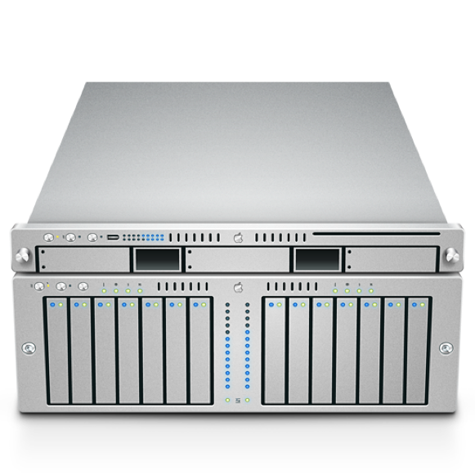

Requirements for the DNS system
Need to handle millions of DNS queries per second
Not immediately obvious how to scale: how do we maintain replication, some measure of consistency?
DNS Server
facebook.com?
31.13.66.35
Notes:
Clearly, a monolithic solution, with one name server for the whole internet, is not feasible.
(Read slide)

Slide 9
DNS distributed system requirements
We need a scalable solution
New hosts keep being added
Number of users increases
Need to maintain speed/responsiveness
We need our service to be available and fault tolerant
It is a crucial basic service
A problematic node shouldn’t “crash the internet”
Reads are more important that writes: far more queries to resolve records than to update them
Global in scope
Domain names mean the same thing everywhere
Notes:
It should now be apparent why DNS is a case study in distributed systems design: It is a system that must scale, both in terms of data and in terms of throughput.
As we’ve seen, the *requirements* of a system greatly influence our design choices. Here are the requirements for DNS:
(Read slide)

Slide 10
Strawman solution: Use a local file
Keep local copy of mapping from all hosts to all IPs (e.g., /etc/hosts)
Space would be reasonable: a few dozen Gbytes.
BUT hosts change IPs regularly, so need to download file frequently
Lot of constant internet bandwidth use
Not scalable!
Notes:
One strawman solution is to keep a copy of all of DNS locally on each computer. The space requirements are feasible– a complete map would require only 4GB or so. But IPs change regularly so we would need to keep the file up to date by syncing it with a remote version. That would lead to way too much traffic.

Slide 11
A tiered architecture yields a scalable solution
Idea: break apart responsibility for each part of a domain name (zone) to a different group of servers
Each zone is a continuous section of the name space, eg *.northeastern.edu
Each zone has an associated set of name servers.

Slide 12
DNS partitions responsibility by “layers”.
Root Servers
Global
Layer
net
org
edu
com
gov
uk
Administrational
Layer
root-servers
northeastern
www
www
khoury
Managerial
Layer
www
Notes:
DNS partitions responsibility by “layers”. In this simplified view, we show a single server responsible for each layer. In practice, each layer might be its own distributed system!
Let’s see how this partitioning is useful in an example that demonstrates how to resolve a name to an address

Slide 13
This is an example of a tiered architecture
Each server need only needs to know about its immediate descendants in its zone.
It only processes requests about a single zone.
Both data and processing are limited to requests about this zone– any other requests are delegated to this server’s parent server.

Slide 14
DNS uses Tree search algorithm
*.edu
*.northeastern.edu
*.khoury.northeastern.edu.
etc.
*.registrar.northeastern.edu.
*.law.northeastern.edu.
Notes:
DNS does a tree search algorithm
Here is the server for northeastern.edu. It knows its own IP address and addresses of its parents and immediate descendants (children).
If I ask it about “northeastern.edu”, it responds with the address.
If I ask it about anything that is not of the form *.northeastern.edu, it forwards the request to its parent (here *.edu).
If I ask it about anything that is of the form *.khoury.northeastern.edu, it forwards the request to the server for *.khoury.northeastern.edu (its child)
If I ask it about anything that is of the form *.registrar.northeastern.edu, it forwards the request to the server for *.registrar.northeastern.edu

Slide 15
Updating name servers
*.edu
*.northeastern.edu
*.khoury.northeastern.edu.
*.registrar.northeastern.edu.
course.khoury.northeastern.edu.
Notes:
This organization pays off again when we go to change IP addresses. If, for example, we change the IP address of course.khoury.northeastern.edu, that requires changing only the table at *.khoury.northeastern.edu . Changes at other nodes, say calendar.registrar.northeastern.edu, don’t propagate to this server.

Slide 16
But some zones are too big and too busy to be handled by a single server
Eg, .edu, .com, .gov, etc.
So these servers are replicated.
Notes:
<Read slide>
Different servers might even use different replication strategies. But we’re not going to get into that.

Slide 17
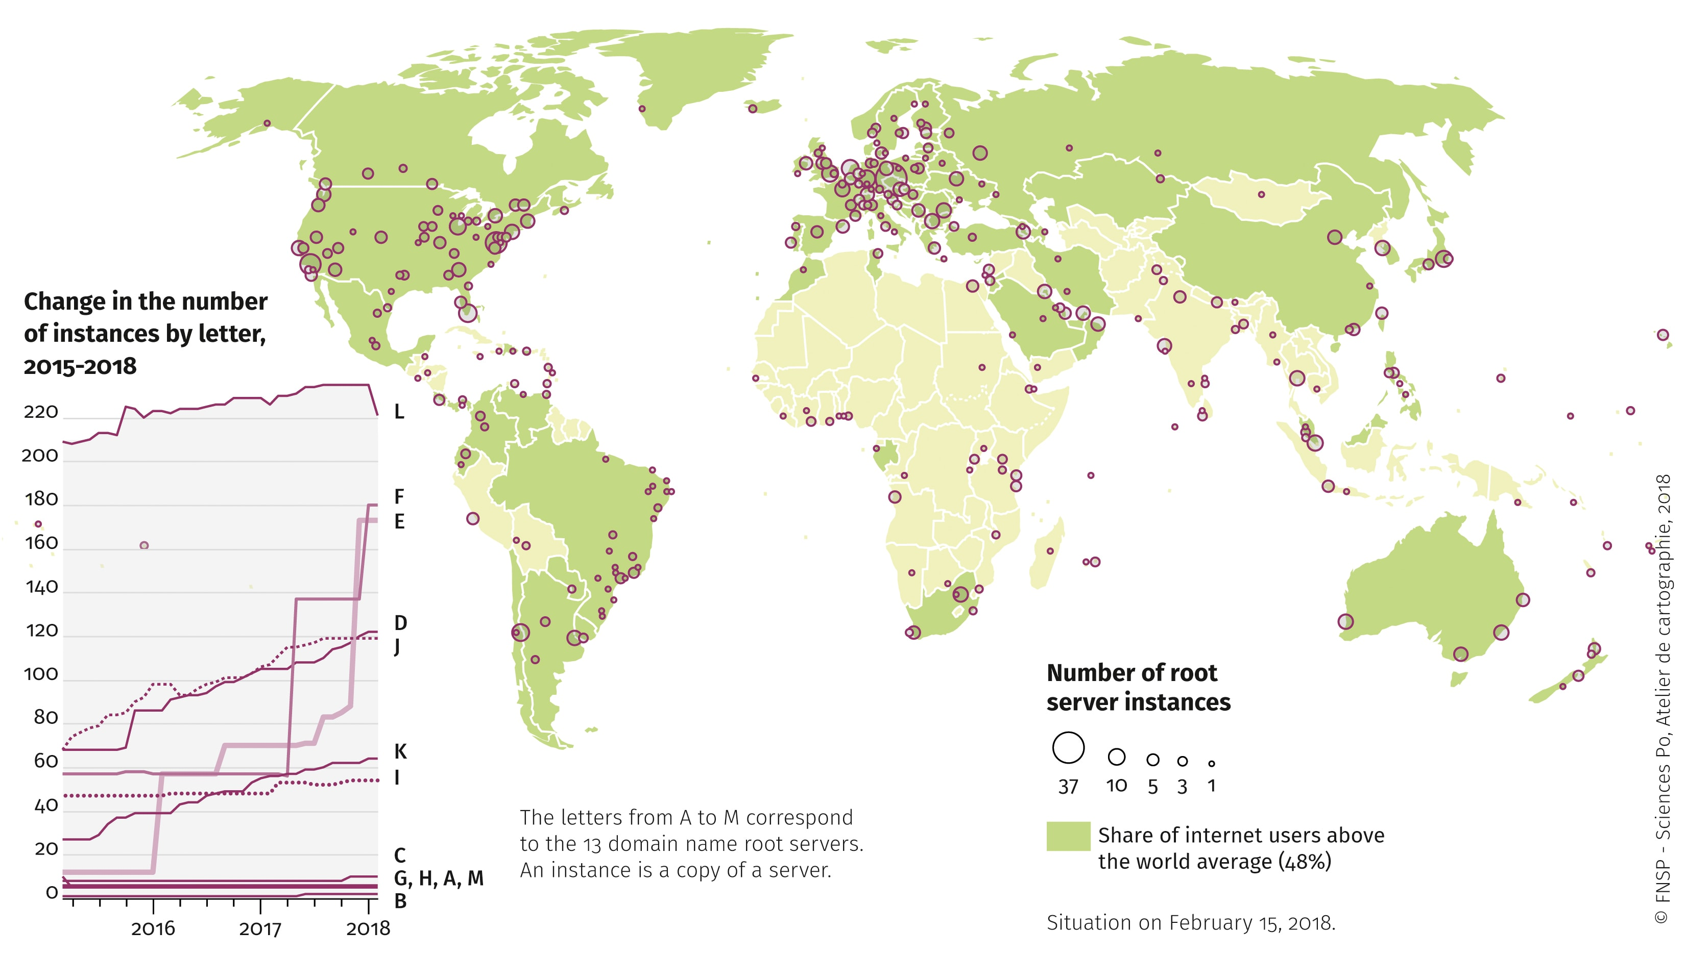
There is replication even within the root servers
13 root servers
[a-m].root-servers.org
E.g., d.root-servers.org
But each root server has multiple copies of the database, which need to be kept in sync.
Somewhere around 1500 replicas in total.

Slide 18
Case Study 4: Reliable Real-Time Chat
Requirements:
Must support real-time text chat for 2,000 users exchanging messages.
Must have best-effort delivery in real-time
Must guarantee that all messages acknowledged are preserved in the central database”
Notes:
Event driven architectures are very useful to compose multiple systems together that have different requirements.
For example: How do we design a system like Slack, which needs to support real-time text chat for potentially thousands of users in the same channel. We want those message to be delivered in real-time (with the least possible latency), but will accept potential failures: if some client is slow to respond to acknowledge a message, we should still keep sending the message to the rest of the clients. But, at the same time, we want to ensure that we have an authoritative record that guarantees that all of the chat messages in a channel are recorded in the order in which they were received, with fault tolerance?
These are conflicting requirements. Building one system that does both things seems impossible.
This is where the idea of an event-driven architecture comes into play

Slide 19
Possible solution: use separate processing units for each requirement.
Allocate separate processing units for these requirements:
“Real time” component optimizes for speed and availability (sacrificing fault-tolerance)
“Persistence” component optimizes for fault-tolerance, sacrificing speed and availability
Event queue service receives events, dispatches to both processing units and is fault tolerant
Notes:
We can take these two conflicting requirements and organize them into two processing units around these responsibilities:
Real time processing unit optimizes for speed and availability of distributing all messages in real time to as many clients as possible. It makes no fault tolerance guarantees - if parts of it fail, clients will not get their messages in real time. However, the clients could still retrieve them (perhaps somewhat slower) from…
Persistence processing unit, which optimizes for fault-tolerance, sacrificing speed and availability. Every message that is received by the persistence processing unit is guaranteed to be available in the future if clients ask for it.
We can then add an event queue service that receives the chat messages from clients and dispatches them to both processing units. The event queue will be fault tolerant in that it has a buffer of messages that have been received, but not yet processed by the “persistence” component. As the persistence component archives the messages, the buffer can be freed.

Slide 20
Block diagram for a real-time chat service
Real Time Chat Service
Client
Fast, not-fault-tolerant real-time service (e.g. Redis)
Reliable message queue (e.g. RabbitMQ)
Client
Client
Reliable database (e.g. PostgreSQL)
Client
Notes:
Here is a high-level architecture diagram that shows how we might go about implementing this real time chat service.
Messages flow into our system, via the message queue and are delivered to both components - the real time service and the persistence service.
We do not show the details of how each of the components is implemented (that’s a topic for another class), but list an example of the kinds of off-the-shelf infrastructure that are likely to be used by each component (RabbitMQ – Rabbit M Q; Redis (read-iss); Postgres (Post-Grehs). Each of those components might be a single server, or a cluster of services. Hooray for abstractions!

Slide 21
Learning Goals for this Lesson
By the end of this lesson you should be able to:
Briefly describe several typical examples of distributed systems
Briefly describe how each of them deals with scalability, fault tolerance, etc.

